Slide 1
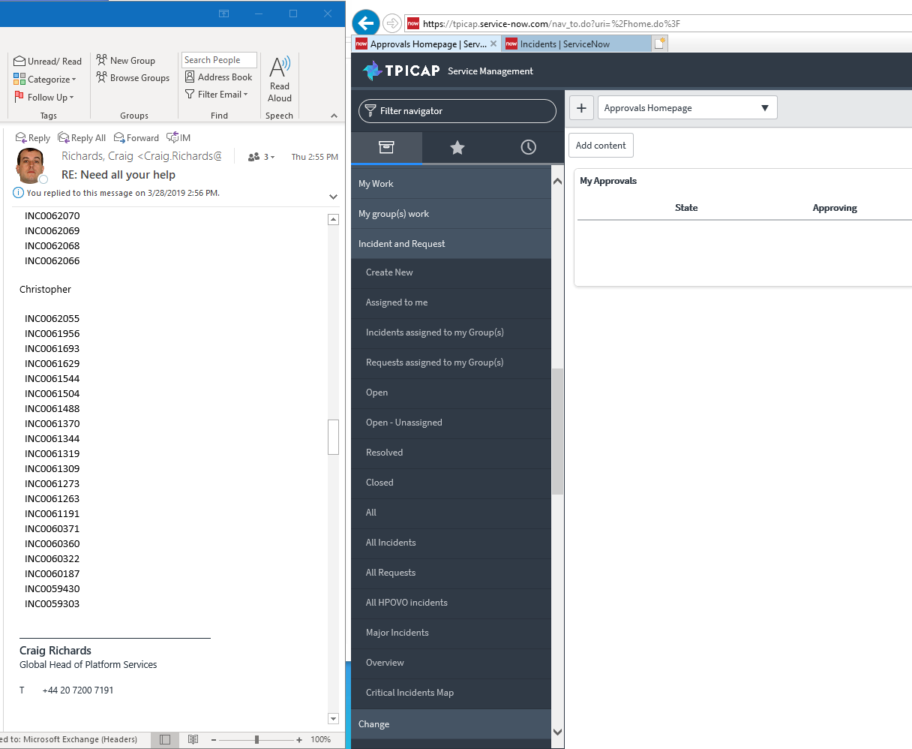
ServiceNOW: Listing Bulk tickets by Number
2. At ServiceNow click “Incident and Request” tab
Note: Instead of copy paste each ticket in snow, you could list in bulk which make it faster
1. Select all the ticket that will list in ServerNOW
3. Select “All Incidents”
Prepared by: Christopher Atienza

Slide 2
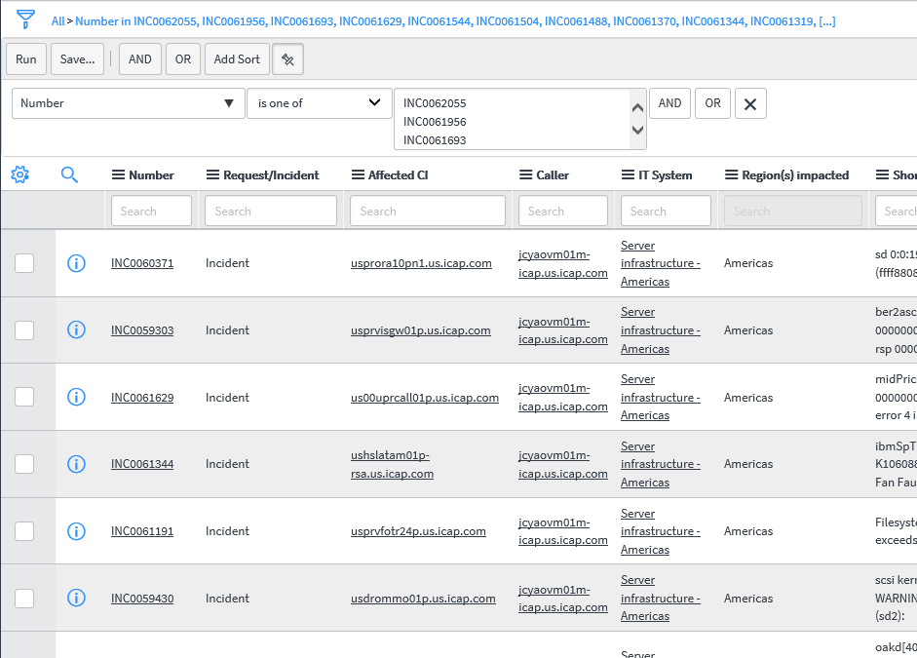
4. Change the field into “Number”, then use “is one of” as filter
5. Paste all the tickets here, then click “Run” button to list all selected tickets
TIP: You could closed update each ticket by filling out all the required fields like Assignment Group Assigned To IT System Regions(s) Impacted Countries Impacted Under Closure Information Section: Close Code Close Notes Then you could click “Save”
6. Hold “CTRL” while click the ticket to open it on new tab of your browser

